Slide 1

Concepts in Enterprise Resource Planning
Fourth Edition
Chapter Six
Human Resources Processes with ERP

Slide 2
Objectives
After completing this chapter, you will be able to:
Explain why the Human Resources function is critical to the success of a company
Describe the key processes managed by a Human Resources department
Describe how an integrated information system can support effective Human Resources processes
Concepts in Enterprise Resource Planning, Fourth Edition
Concepts in Enterprise Resource Planning, Fourth Edition

Slide 3
Introduction
Human capital management (HCM): tasks associated with managing a company’s workforce
Human Resources (HR) department responsibilities
  Attracting, selecting, and hiring new employees
  Communicating information regarding new positions and hires
  Ensuring proper education, training, and certification for employees
  Handling issues related to employee conduct
  Making sure employees understand job responsibilities
Concepts in Enterprise Resource Planning, Fourth Edition

Slide 4
Introduction (cont’d.)
Human Resources (HR) department responsibilities (cont’d.)
  Using effective process to review employee performance and determine salary increases and bonuses
  Managing salary and benefits for each employee
  Communicating changes in salaries, benefits, or policies to employees
  Supporting management plans for changes in the organization
Concepts in Enterprise Resource Planning, Fourth Edition

Slide 5
Problems with Fitter Snacker’s Human Resources Processes
Personnel management relies on paper records and a manual filing system
  Creates problems
  Information is not readily accessible or easy to analyze
Concepts in Enterprise Resource Planning, Fourth Edition

Slide 6
Recruiting Process
Fitter Snacker (FS) has three employees in its HR department
Problems occur because of:
  Large number of HR processes (from hiring and firing to managing health benefits)
  Lack of integration among all departments
  Number of people with whom HR interacts
  Inaccurate, out-of-date, and inconsistent information
Concepts in Enterprise Resource Planning, Fourth Edition

Slide 7
Recruiting Process (cont’d.)
Problems that can arise in the recruiting process:
  Description of qualifications required for the job may be incomplete or inaccurate
  Job vacancy form may be lost or not routed properly
    Human Resources department will not know that the position is available
    Supervisor will assume that paperwork is in process
Filing and properly keeping track of resumes and applications is a challenge at Fitter Snacker
  Due to applicant’s data being kept on paper form
Concepts in Enterprise Resource Planning, Fourth Edition

Slide 8
The Interviewing and Hiring Process
At FS, requesting department develops a short list of candidates based on data provided by HR
Human Resources department:
  Contacts candidates on the short list
  Schedules interviews
  Creates a file for each candidate
If a candidate accepts an interview offer, HR makes arrangements for the interview
  After the initial interview, HR updates candidate’s file to indicate whether he or she is a possibility for hire
Concepts in Enterprise Resource Planning, Fourth Edition

Slide 9
The Interviewing and Hiring Process (cont’d.)
Second interview may be scheduled
HR representative and supervisor of requesting department decide which candidates are acceptable and rank them
HR person makes the highest-ranking candidate a job offer
Acceptance of job offer by candidate
Concepts in Enterprise Resource Planning, Fourth Edition

Slide 10
The Interviewing and Hiring Process (cont’d.)
Many of Fitter Snacker’s problems in interviewing and hiring process deal with information flow and communication
After candidate accepts formal job offer, Fitter Snacker hires an HR consulting firm to perform a background check
Fitter Snacker frequently has problems enrolling new employees in correct benefits plans and establishing proper payroll deductions
Concepts in Enterprise Resource Planning, Fourth Edition

Slide 11
Human Resources Duties after Hiring
HR department should maintain good, continual communication with employee and supervisor to make sure the employee is performing well
Fitter Snacker issues performance evaluations to new and current employees
  Evaluation documents become part of employee’s file; maintained by HR department
Concepts in Enterprise Resource Planning, Fourth Edition

Slide 12
Human Resources Duties after Hiring (cont’d.)
Not having an effective information system makes it difficult for Fitter Snacker:
  To manage all of the performance evaluation data
  For HR department to identify problems with an employee and take corrective action
  To maintain proper control of sensitive personal information
Concepts in Enterprise Resource Planning, Fourth Edition

Slide 13
Human Resources Duties after Hiring (cont’d.)
Employee turnover can be a significant problem
  Costs related to hiring and training new employees
  Companies lose knowledge and skills that may be crucial to keeping them competitive
  Employee turnover is strongly related to job satisfaction and compensation
Concepts in Enterprise Resource Planning, Fourth Edition

Slide 14
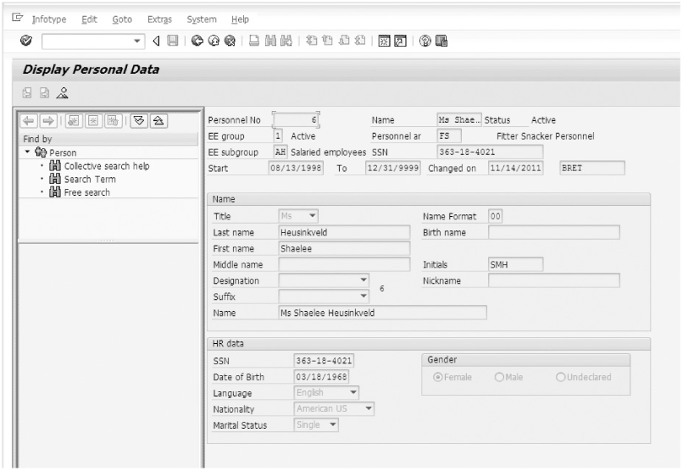
Human Resources with ERP Software
Figure 6-1 Personal data stored in SAP Human Resources software
Concepts in Enterprise Resource Planning, Fourth Edition

Slide 15
Human Resources with ERP Software
A good information system allows all relevant information for an employee to be retrieved in a matter of seconds
SAP ERP Human Resources (HR) module provides tools for:
  Managing an organization’s roles and responsibilities
  Definitions
  Personal employee information
  Tasks related to time management, payroll, travel management, and employee training
Concepts in Enterprise Resource Planning, Fourth Edition

Slide 16
Human Resources with ERP Software (cont’d.)
SAP ERP’s Organization and Staffing Plan tool used to define:
  Company’s management structure
  Positions within the organizational structure
SAP ERP distinguishes between task, job, position, and person
Manager’s Desktop tool within SAP HR module
  Provides access to all Human Resources data and transactions in one location
Concepts in Enterprise Resource Planning, Fourth Edition

Slide 17
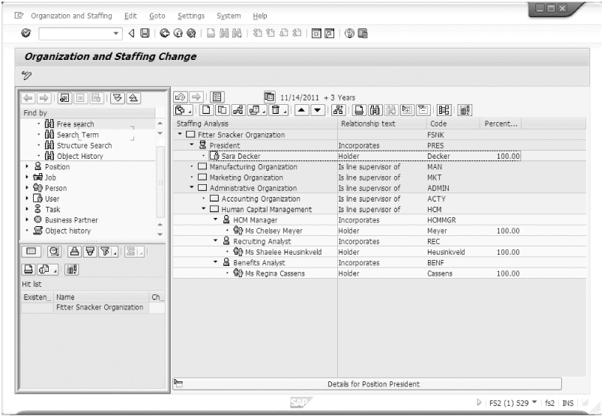
Figure 6-2 Organization and staffing plan in SAP ERP
Concepts in Enterprise Resource Planning, Fourth Edition

Slide 18
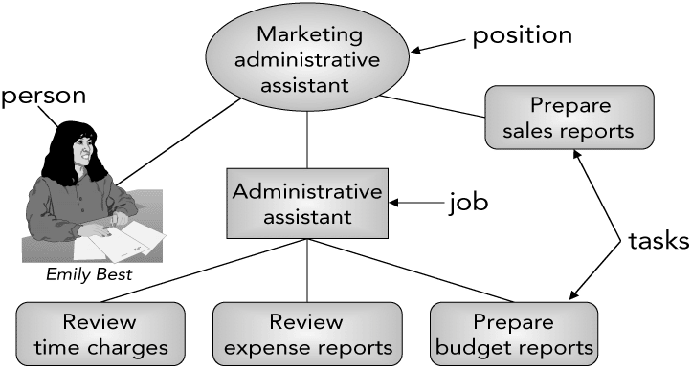
Human Resources with ERP Software (cont’d.)
Figure 6-3 Relationships among positions, jobs, tasks, and persons who fill positions
Concepts in Enterprise Resource Planning, Fourth Edition

Slide 19
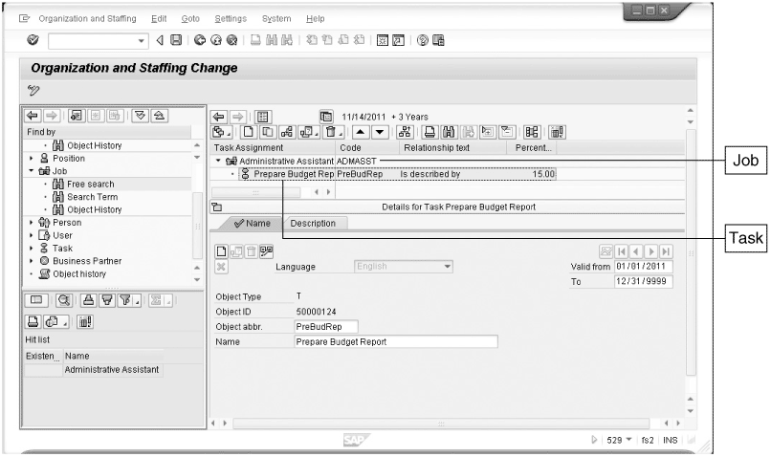
Human Resources with ERP Software (cont’d.)
Figure 6-4 Assignment of a task to a job in SAP ERP
Concepts in Enterprise Resource Planning, Fourth Edition

Slide 20
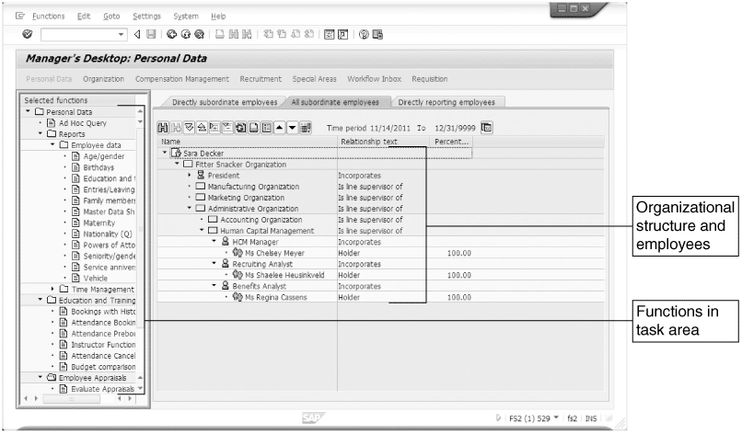
Human Resources with ERP Software (cont’d.)
Figure 6-5 Manager’s Desktop provides single-point access to HR functions
Concepts in Enterprise Resource Planning, Fourth Edition

Slide 21
Advanced SAP ERP Human Resources Features
Time management
Payroll processing
Travel management
Training and development
Concepts in Enterprise Resource Planning, Fourth Edition

Slide 22
Time Management
Hourly employees
  Paid for each hour worked
  Must record time that they work
Salaried employees
  Not paid based on hours worked
  Their time worked usually must be tracked as well
Concepts in Enterprise Resource Planning, Fourth Edition

Slide 23
Time Management (cont’d.)
SAP ERP system uses Cross Application Time Sheets (CATS) to:
  Record employee working times
  Provide the data to applications including:
    SAP Controlling module
    SAP Payroll module
    SAP Production Planning module
Concepts in Enterprise Resource Planning, Fourth Edition

Slide 24
Payroll
Remuneration elements of an employee’s pay
  Base pay, bonuses, gratuities, overtime, sick pay, and vacation allowances
Statutory and voluntary deductions
  Taxes (federal, state, local, Social Security, and Medicare), company loans, and benefit contributions
Payroll run: process of determining each employee’s pay
  SAP ERP system evaluates input data and notes any discrepancies in error log
Concepts in Enterprise Resource Planning, Fourth Edition

Slide 25
Travel Management
Travel request may originate with employee or employee’s manager
Travel requests usually require management approval
Once travel request is approved, travel reservations must be made
Concepts in Enterprise Resource Planning, Fourth Edition

Slide 26
Travel Management (cont’d.)
SAP ERP Travel Management system
  Maintains travel data for each employee, including flight, hotel, and car preferences
  Integrates travel data with:
    Payroll module for reimbursements
    Financial Accounting and Controlling modules to properly record travel expenses
Concepts in Enterprise Resource Planning, Fourth Edition

Slide 27
Training and Development
In SAP ERP system, employee development is driven by qualifications and requirements
  Requirements: skills or abilities associated with a position
  Qualifications: skills or abilities associated with a specific employee
One of the most important reasons for managing the development and training of employees is succession planning
Concepts in Enterprise Resource Planning, Fourth Edition

Slide 28
Training and Development (cont’d.)
Succession plan outlines strategy for replacing key employees when they leave the company
Career and Succession Planning components of SAP ERP Human Resources module
  Allow HR professionals to create, implement, and evaluate succession planning scenarios
Concepts in Enterprise Resource Planning, Fourth Edition

Slide 29
Additional Human Resources Features of SAP ERP
Mobile time management
Management of family and medical leave
Domestic partner handling
Administration of long-term incentives
Personnel cost planning
Management and payroll for global employees
Management by objectives
Concepts in Enterprise Resource Planning, Fourth Edition

Slide 30
Mobile Time Management
Many employees may not have regular access to a PC
Mobile Time Management allows employees to use cellular phones to:
  Record their working times
  Record absences
  Enter a leave request
  Check their time charge data
Concepts in Enterprise Resource Planning, Fourth Edition

Slide 31
Management of Family and Medical Leave
Human Resources module reduces administrative burden imposed by Family and Medical Leave Act (FMLA) of 1993
HR system can:
  Determine whether an employee is eligible to take FMLA absences
  Automatically deducts those absences from the days the employee takes from allowable leave
Concepts in Enterprise Resource Planning, Fourth Edition

Slide 32
Domestic Partner Handling
Human Resources module now supports the management of benefits for domestic partners and their children
Provides more flexibility in:
  Customizing dependent coverage options for health plans
  Eligibility for enrollment of dependents
  Designation of beneficiaries
Concepts in Enterprise Resource Planning, Fourth Edition

Slide 33
Administration of Long-Term Incentives
Companies must account for expected costs that occur as a result of long-term incentives such as the exercising of stock options
Human Resources module now provides more options for processing long-term incentives
  Integration with SAP Payroll module
    Can calculate taxes accurately when employees exercise incentives and sell their shares in the company
  SAP can share incentive data with Accounting
Concepts in Enterprise Resource Planning, Fourth Edition

Slide 34
Personnel Cost Planning
Personnel Cost Planning tool
  Allows HR personnel to define and evaluate planning scenarios to generate cost estimates
Performing cost planning and simulation
  Allows HR to forecast cost estimates by integrating data with other SAP ERP modules
Concepts in Enterprise Resource Planning, Fourth Edition

Slide 35
Management and Payroll for Global Employees
Management of global employees involves many complicated issues
  Relocation plans, visas and work permits, housing, taxes, bonus pay
SAP ERP has enhanced features to support the management of these issues
  Customized functionality for more than 50 countries
Concepts in Enterprise Resource Planning, Fourth Edition

Slide 36
Management by Objectives
Management by objectives (MBO)
  1954: first outlined by Peter Drucker in The Practice of Management
  Managers encouraged to focus on results, not activities, and to “negotiate a contract of goals” with their subordinates without dictating the exact methods for achieving them
Concepts in Enterprise Resource Planning, Fourth Edition

Slide 37
Management by Objectives (cont’d.)
SAP ERP provides a comprehensive process to support the MBO approach
  Performance appraisals
    Appraisal results can affect employee’s compensation
  Managers can include results of achieved objectives in the employee’s qualifications profile
Concepts in Enterprise Resource Planning, Fourth Edition

Slide 38
Summary
Employees are among a company’s most important assets
  Without qualified and motivated employees, a company cannot succeed
Human Resources department responsible for:
  Ensuring that the company can find, evaluate, hire, develop, evaluate, and compensate the right employees to achieve the company’s goals
  Employee training and development, succession planning, and termination
Concepts in Enterprise Resource Planning, Fourth Edition

Slide 39
Summary (cont’d.)
Managing, sharing, controlling, and evaluating the data required to manage a company’s human capital are simplified by an integrated information system
Additional features of SAP HR systems address today’s changing technology and legislation
Concepts in Enterprise Resource Planning, Fourth Edition

